Slide 1
The 8051 Microcontroller and Embedded Systems
CHAPTER 2
8051 ASSEMBLY LANGUAGE PROGRAMMING

Slide 2
OBJECTIVES
List the registers of the 8051 microcontroller
Manipulate data using the registers and MOV instructions
Code simple 8051 Assembly language instructions
Assemble and run an 8051 program
Describe the sequence of events that occur upon 8051 power-up
Examine programs in ROM code of the 8051
Explain the ROM memory map of the 8051
Detail the execution of 8051 Assembly language instructions
Describe 8051 data types
Explain the purpose of the PSW (program status word) register
Discuss RAM memory space allocation in the 8051
Diagram the use of the stack in the 8051

Slide 3
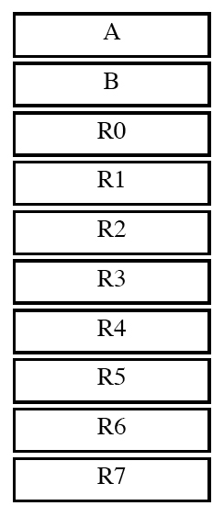
SECTION 2.1: INSIDE THE 8051
Registers
Figure 2–1a
Some 8-bit Registers of the 8051

Slide 4
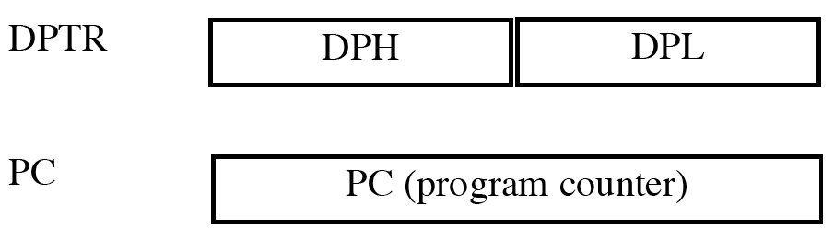
SECTION 2.1: INSIDE THE 8051
Registers
Figure 2–1b Some 8051 16-bit Registers

Slide 5
SECTION 2.1: INSIDE THE 8051
most widely used registers are A, B, R0, R1, R2, R3, R4, R5, R6, R7, DPTR and PC
all registers are 8-bits, except DPTR and the program counter which are 16 bit
register A is used for all arithmetic and logic instructions
simple instructions MOV and ADD

Slide 6
SECTION 2.1: INSIDE THE 8051
MOV instruction
  MOV destination, source ;copy source to destination
MOV A,#55H ;load value 55H into reg A
MOV R0,A ;copy contents of A into R0 (A=R0=55H)
MOV R1,A ;copy contents of A into R1 (A=R0=R1=55H)
MOV R2,A ;copy contents of A into R2 (A=R0=R1=R2=55H)
MOV R3,#95H ;load value 95H into R3 (R3=95H)
MOV A,R3 ;copy contents of R3 into A (A=R3=95H)

Slide 7
SECTION 2.1: INSIDE THE 8051
ADD instruction
  ADD A, source ;ADD the source operand
  ;to the accumulator
  MOV A,#25H ;load 25H into A
  MOV R2,#34H ;load 34H into R2
  ADD A,R2 ;add R2 to accumulator
  Executing the program above results in A = 59H

Slide 8
SECTION 2.2: INTRODUCTION TO 8051 ASSEMBLY PROGRAMMING
Structure of Assembly language
ORG 0H ;start (origin) at 0
MOV R5,#25H ;load 25H into R5
MOV R7,#34H ;load 34H into R7
MOV A,#0 ;load 0 into A
ADD A,R5 ;add contents of R5 to A
;now A = A + R5
ADD A,R7 ;add contents of R7 to A
;now A = A + R7
ADD A, #12H ;add to A value 12H
;now A = A + 12H
HERE: SJMP HERE ;stay in this loop
END ;end of asm source file
Program 2-1: Sample of an Assembly Language Program

Slide 9
SECTION 2.3: ASSEMBLING AND RUNNING AN 8051 PROGRAM
An Assembly language instruction consists of four fields:
[label : ] mnemonic [operands] [;comment]

Slide 10
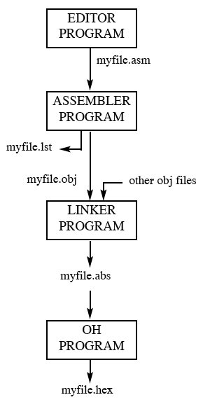
SECTION 2.3: ASSEMBLING AND RUNNING AN 8051 PROGRAM
Figure 2–2 Steps to Create a Program

Slide 11
SECTION 2.3: ASSEMBLING AND RUNNING AN 8051 PROGRAM
More about "a51" and "obj" files
  "asm" file is source file and for this reason some assemblers require that this file have the “a51" extension
  this file is created with an editor such as Windows Notepad or uVision editor
  uVision assembler converts the a51 assembly language instructions into machine language and provides the obj file
  assembler also produces the Ist file

Slide 12
SECTION 2.3: ASSEMBLING AND RUNNING AN 8051 PROGRAM
Ist file
  lst file is useful to the programmer because it lists all the opcodes and addresses as well as errors that the assembler detected
  uVision assumes that the list file is not wanted unless you indicate that you want to produce it
  file can be accessed by an editor such as Note Pad and displayed on the monitor or sent to the printer to produce a hard copy
  programmer uses the list file to find syntax errors
  only after fixing all the errors indicated in the lst file that the obj file is ready to be input to the linker program

Slide 13
SECTION 2.4: THE PROGRAM COUNTER AND ROM SPACE IN THE 8051
Program counter in the 8051
  16 bits wide
  can access program addresses 0000 to FFFFH
  total of 64K bytes of code

Slide 14
SECTION 2.4: THE PROGRAM COUNTER AND ROM SPACE IN THE 8051
Where the 8051 wakes up when it is powered up:
  wakes up at memory address 0000 when it is powered up
  first opcode must be stored at ROM address 0000H

Slide 15
SECTION 2.4: THE PROGRAM COUNTER AND ROM SPACE IN THE 8051
Placing code in program ROM
  the opcode and operand are placed in ROM locations starting at memory 0000

Slide 16
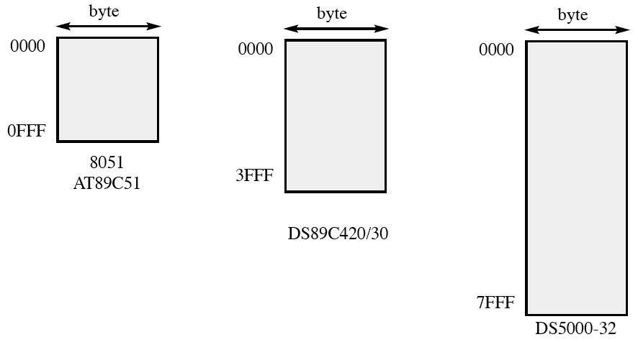
SECTION 2.4: THE PROGRAM COUNTER AND ROM SPACE IN THE 8051
ROM memory map in the 8051 family
Figure 2–3 8051 On-Chip ROM Address Range

Slide 17
SECTION 2.5: 8051 DATA TYPES AND DIRECTIVES
8051 data type and directives
  DB (define byte)
  ORG (origin)
  EQU (equate)
  END directive

Slide 18
SECTION 2.5: 8051 DATA TYPES AND DIRECTIVES
Rules for labels in Assembly language
  each label name must be unique
  first character must be alphabetic
  reserved words must not be used as labels

Slide 19
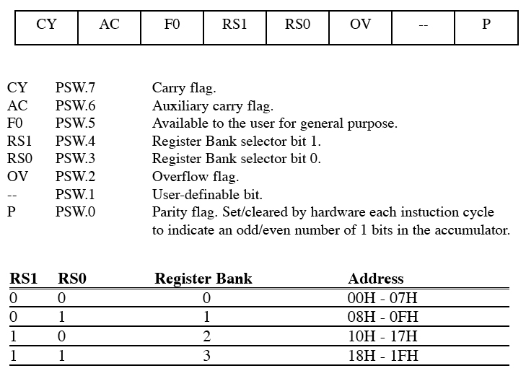
SECTION 2.6: 8051 FLAG BITS AND THE PSW REGISTER
PSW (program status word) register
Figure 2–4 Bits of the PSW Register

Slide 20
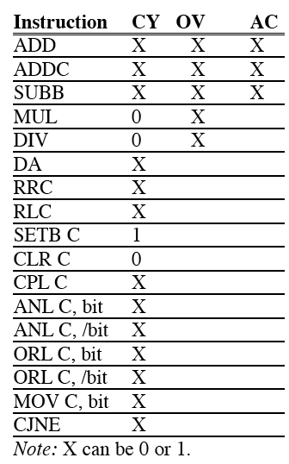
SECTION 2.6: 8051 FLAG BITS AND THE PSW REGISTER
Table 2–1 Instructions That Affect Flag Bits

Slide 21
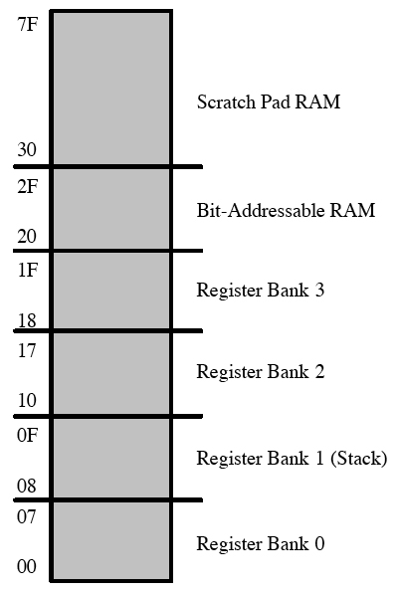
SECTION 2.7: 8051 REGISTER BANKS AND STACK
RAM memory space allocation in the 8051
Figure 2–5
RAM Allocation in the 8051

Slide 22
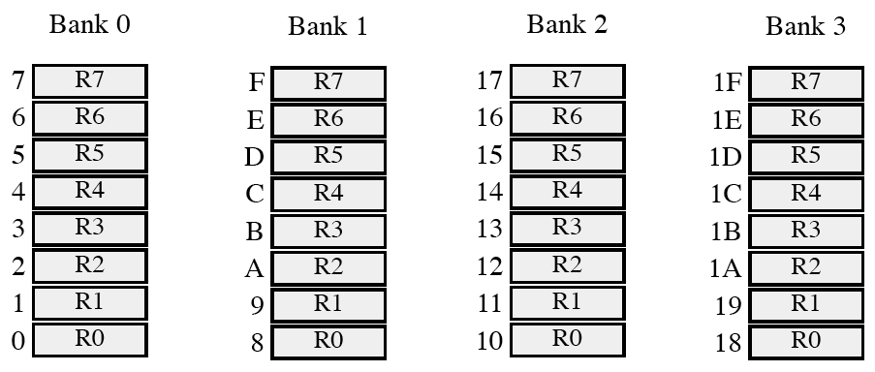
SECTION 2.7: 8051 REGISTER BANKS AND STACK
Register banks in the 8051
Figure 2–6 8051 Register Banks and their RAM Addresses

Slide 23
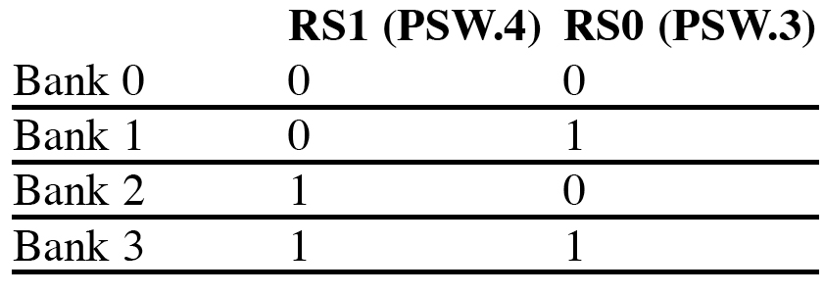
SECTION 2.7: 8051 REGISTER BANKS AND STACK
How to switch register banks
Table 2–2 PSW Bits Bank Selection

Slide 24
SECTION 2.7: 8051 REGISTER BANKS AND STACK
Stack in the 8051
  section of RAM used to store information temporarily
  could be data or an address
  CPU needs this storage area since there are only a limited number of registers

Slide 25
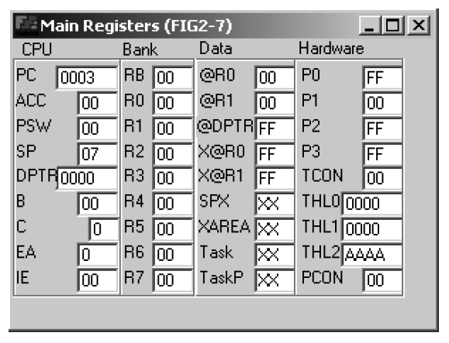
SECTION 2.7: 8051 REGISTER BANKS AND STACK
Viewing registers and memory with a simulator
Figure 2–7
Register’s Screen from
ProView 32 Simulator

Slide 26
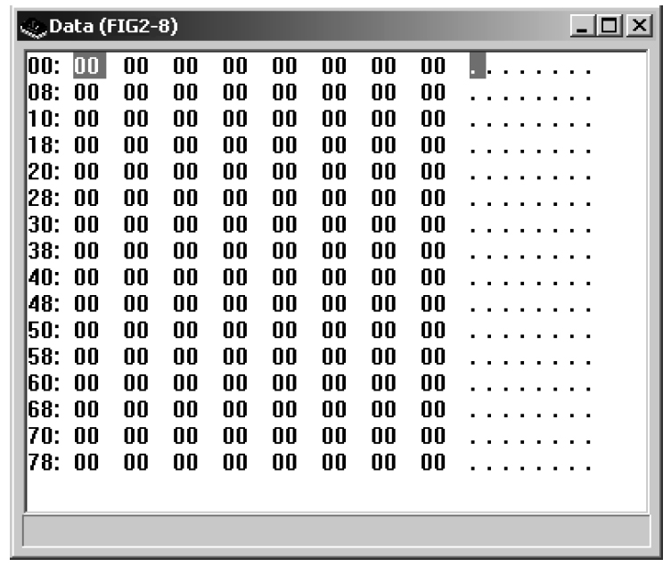
SECTION 2.7: 8051 REGISTER BANKS AND STACK
Figure 2–8 128-Byte Memory Space from ProView 32 Simulator

Slide 27
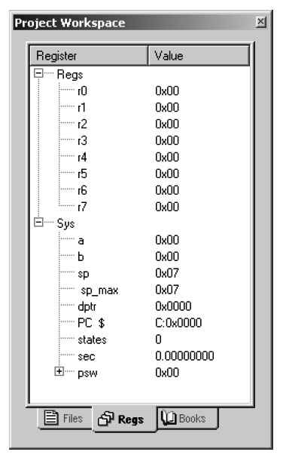
SECTION 2.7: 8051 REGISTER BANKS AND STACK
Figure 2–9 Register’s Screen from Keil Simulator

Slide 28
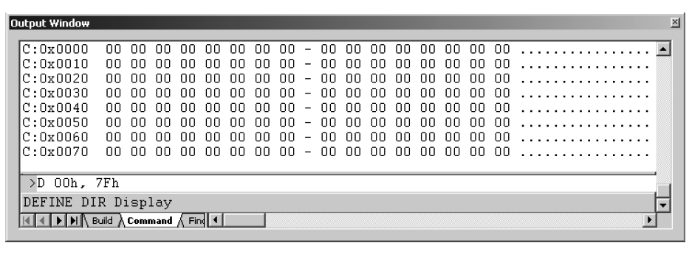
SECTION 2.7: 8051 REGISTER BANKS AND STACK
Figure 2–10 128-Byte Memory Space from Keil Simulator

Slide 29
Next …
Lecture Problems Textbook Chapter 2
  Answer as many questions as you can and submit via MeL before the end of the lecture.
Proteus Exercise Textbook Chapter 2
  Do as much of the Proteus exercise as you can and submit via MeL before the end of the lecture.

